Slide 1



March 2020
CoLabora / SCUGDK

Slide 2
Agenda
09:00 Welcome (Kent, Ronni Peter) 09:15 Manage Intune with PowerShell & Graph (Timmy Andersson) 09:45 Q&A Manage Intune with PowerShell & Graph 09:55 Socialize alone 10:00 Making the transition to Microsoft Edge Chromium (Jörgen Nilsson) 10:30 Q&A - Making the transition to Microsoft Edge Chromium 10:40 Socialize alone 10:50 What's new with Bitlocker Management & Endpoint Manager (Niall Brady) 11:20 Q&A What's new with Bitlocker Management & Endpoint Manager 11:30 Lunch Break 11:50 PatchMyPC (Justin Chalfant) 12.20 Using Sensitivity Labels with Teams (Peter Schmidt) 12.50 Q&A - Using Sensitivity Labels with Teams 13.00 How to prepare for calling and meetings in Teams (Lasse Nordvik Wedø) 13.30 Q&A - How to prepare for calling and meetings in Teams 13.40 Socialize alone 13.50 Office 365 DLP end to end (Steve Goodman) 14.20 Q&A - Office 365 DLP end to end 14.30 Devices and meeting rooms, why they matter and how to build your home office (Ståle Hansen) 15.00 Q&A - Devices and meeting rooms, why they matter and how to build your home office 15.10 Wrap-up session (Kent, Ronni og Peter)

Slide 3
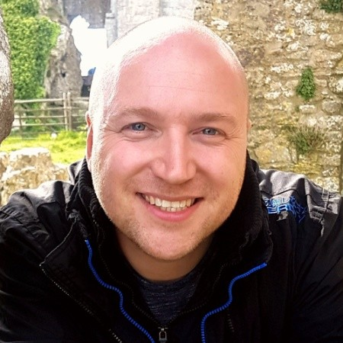
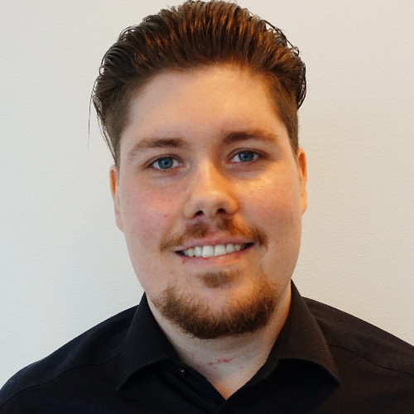
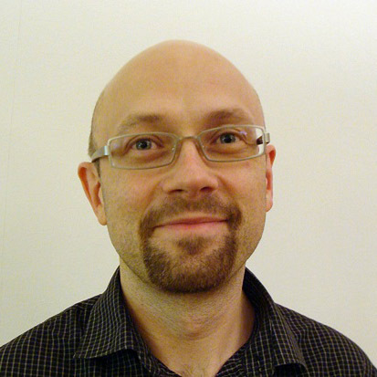
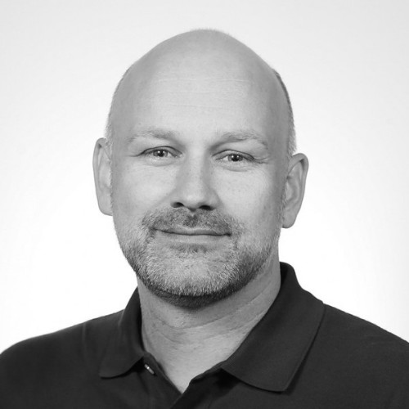
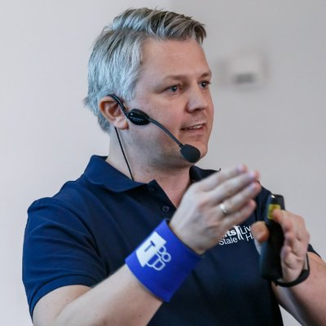
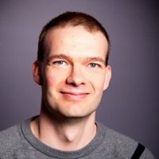
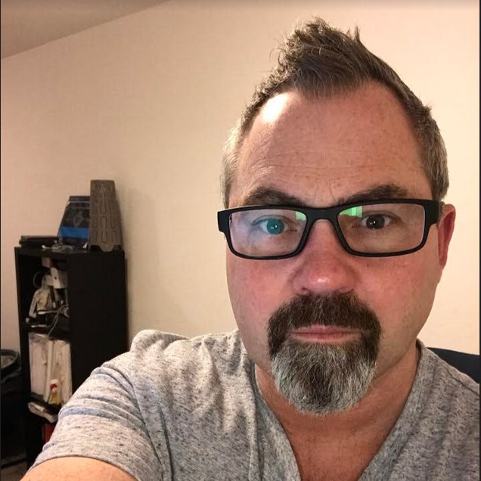
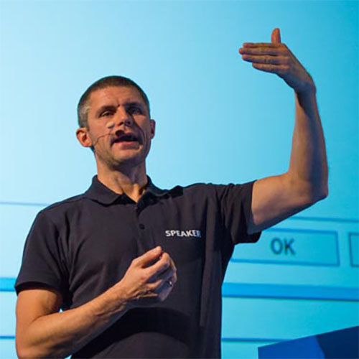
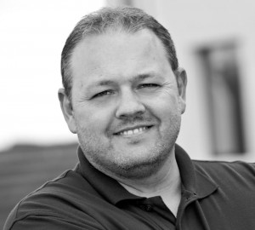
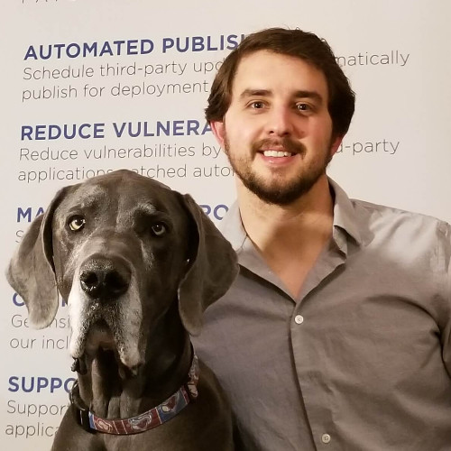
Welcome our speakers

Slide 4

CoLabora / SCUGDK
The idea behind our user groups
Community to share knowledge
Focus on Microsoft 365
Online/Offiline events / meetups
Non-profit organizations
Upcoming Events
CoLabora – 6 events/year
SCUGDK – 4/5 events/year
Other Events
Techorama BE (May)
ExpertsLive NO (May)
ExpertsLive NL (June)
MMS (July)
Workplace Ninja Summit
Microsoft Ignite 2020

Slide 5
The Team Behind CoLabora
Ronni Pedersen
Cloud Architect
APENTO
Microsoft MVP: Enterprise Mobility
Microsoft Certified Trainer
Contact Me
Twitter: @ronnipedersen
Blog: https://www.ronnipedersen.com/
Mail: rop@apento.com
Phone: +45 2085 9452
Peter Schmidt
Cloud Architect
NeoConsulting
Microsoft MVP: Office Apps and Services
Microsoft Certified Master
Contact Me
Twitter: @petsch
Blog: https://www.msdigest.net/
Mail: peter@neoconsulting.dk
Phone: +45 2080 9436

Slide 6
The Team Behind SCUGDK
Ronni Pedersen
Cloud Architect
APENTO
Microsoft MVP: Enterprise Mobility
Microsoft Certified Trainer
Contact Me
Twitter: @ronnipedersen
Blog: https://www.ronnipedersen.com/
Mail: rop@apento.com
Phone: +45 2085 9452
Kent Agerlund
Principal Consultant
CTGlobal
Microsoft MVP: Enterprise Mobility
Microsoft Regional Director
Contact Me
Twitter: @agerlund
Blog: https://blog.ctglobalservices.com/kea/
Mail: kea@ctglobalservices.com
Phone: +45 26 16 90 54

Slide 7
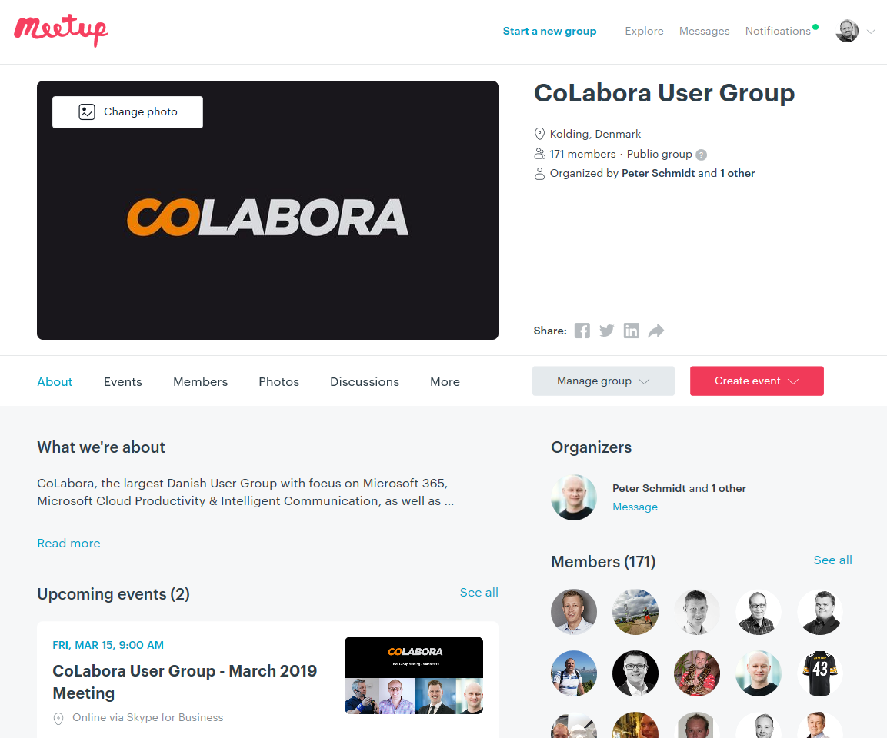
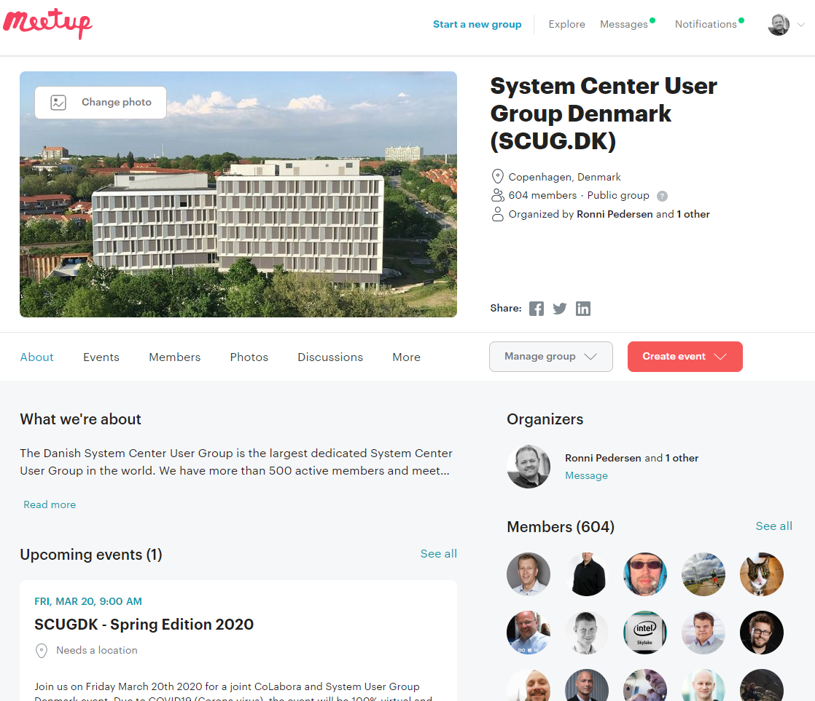
Meetup.com

Slide 8
Practical information
Wifi: Ask your wife…
Turn off your cell phones ☺
Mute your microphones
Turn on your Webcams
The entire Meetup is a non-smoking area ☺
You are welcome to bring refreshments to the meetup
The evaluation and feedback
Q and A in chat during sessions (no small talk and jokes)

Slide 9
Join the Community
Join the conversation on the social media and use
#CoLaboraDK and #SCUGDK

Slide 10
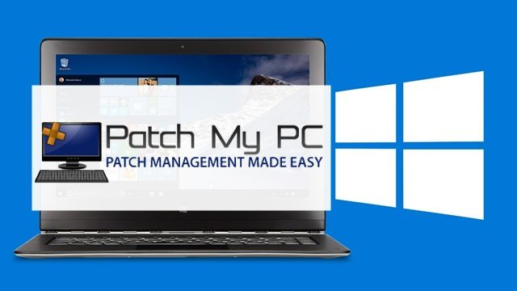





Our Sponsors
We’re still looking ☺

Slide 11

Let’s begin
Enjoy the day…

